Slide 1

Team Philippines
Learning Analytics Hackathon Presentation 2022
2022/11/05
Bryan Chang, Jonathan Chow, Chris Qiu

Slide 2
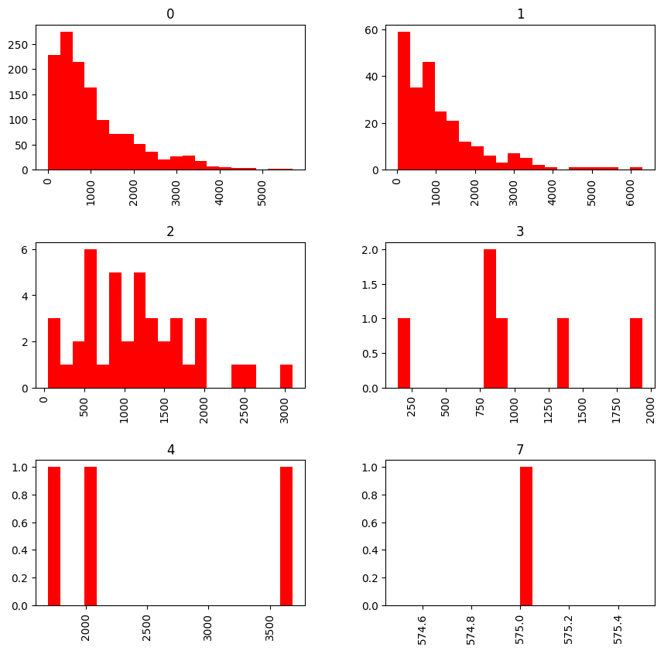
Histograms of Length of Messages, Grouped by Like Counts
Mean of Each Group:
0 Likes: 1072.201662
1 Likes: 1098.388186
2 Likes: 1144.600000
3 Likes: 996.833333
4 Likes: 2465.000000
7 Likes: 575.000000

Slide 3
Implication?
There likely is no correlation between the length of a message and the number of likes it received. We thought this was of interest since people’s attention spans tend to deteriorate after reading too much (we can all attest to this).

Slide 4
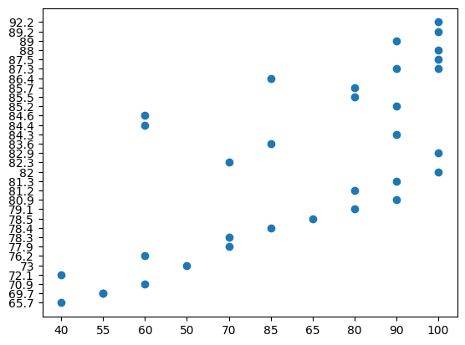
There appears to be a moderate positive correlation between participation or engagement scores with the overall student grade.

Slide 5
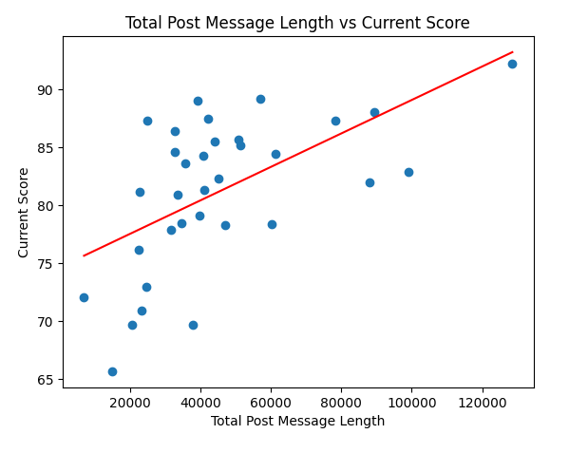
Total post message length is positively correlated with higher class grades.

Slide 6
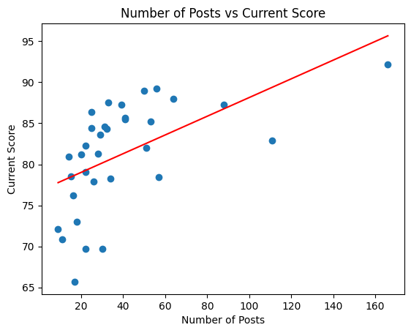
Students who post more appear to achieve higher scores, although this correlation may be logarithmic in nature.

Slide 7
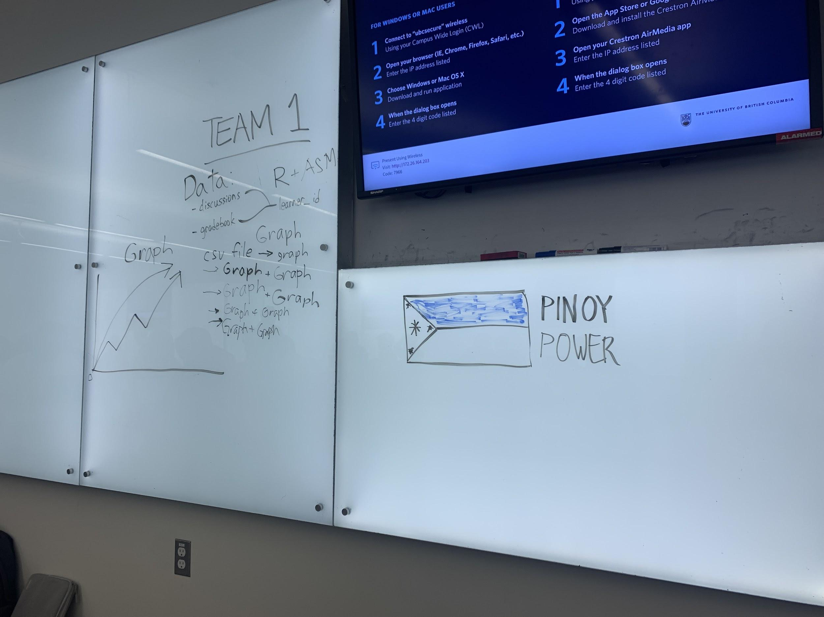
The Thought Process
The process behind our thinking
We trust the process

Slide 8

Conclusion
Students who engage more in class discussions on Canvas appear to have higher class scores, although this relationship may be more logarithmic than linear in nature. The factors for engagement (post type, post length, etc.) are unclear as to whether they have any effect on students’ grades at all.

